Slide 1




12 - 16 April 2021
New visibility.
New leads.
New business.
hannovermesse.com #HM21

Slide 2
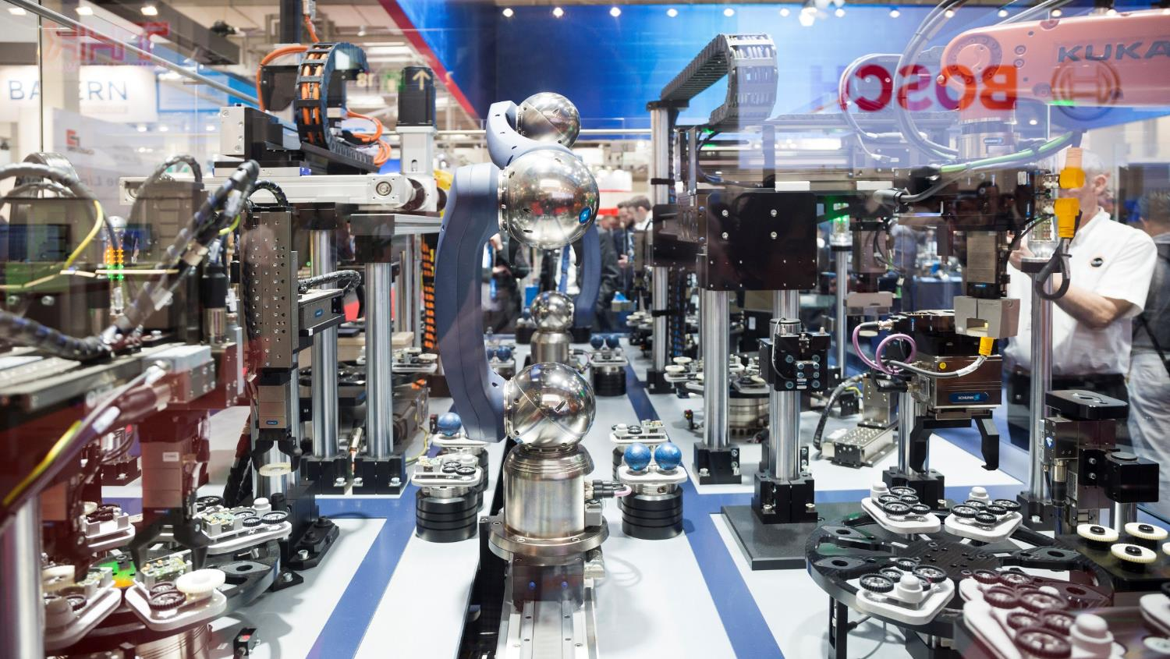
Smart Grids
Platform Economies
Automation
Cyber Security
Artificial Intelligence
Logistics 4.0
Man-Machine Collaboration
Lightweight Design
Robotics
Sector Coupling
Smart Supply
Connectivity
Knowledge Transfer
Industrie 4.0
5G Network
Digital Twin
E-Mobility
Integrated Energy
Blockchain
Notes:
HANNOVER MESSE is the global hotspot for the digital transformation of industry.
Companies are using technologies such as artificial intelligence, automation and robotics to fundamentally change the way they design, produce and distribute their products and services
The topics you see listed on this chart belong to those that are driving the digitalization of manufacturing, energy and logistics systems.
These are the key topics at HANNOVER MESSE in 2019.

Slide 3
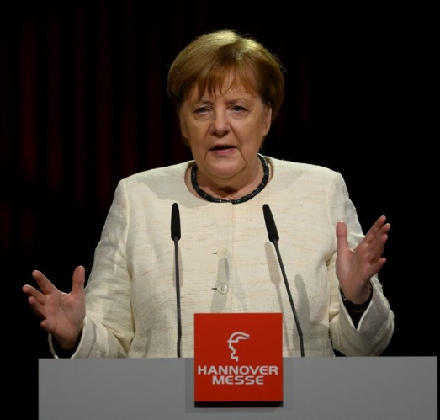
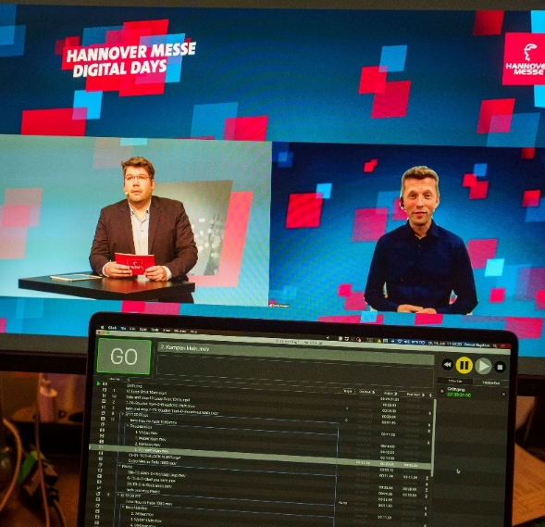
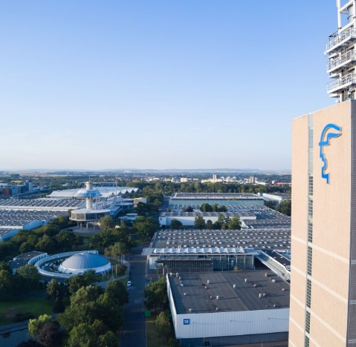

hannover messe 2021 takes place!
Industry needs a top event to showcase innovation and to network
DIGITAL participation possibilities MAXIMIZE THE RANGE of the event
Live TV Studio and Stages for Online Conference Program hygiene concept maximum security
Notes:
Die HM 2021 findet im April statt!
Die Industrie – allen voran der führende deutsche Mittelstand – braucht ein nationales Spitzenevent zur Präsentation von Innovationen, Diskussion der aktuellen und zukünftigen Trends sowie den Austausch zwischen Unternehmen, Forschung und Politik!
Digitale Formate können dabei perfekt ergänzen und die Reichweite verlängern – ersetzen aber den persönlichen Kontakt nicht!
Das Messegelände in Hannover bietet dabei optimale Bedingungen für die Durchführung von Messen in Pandemie-Zeiten:
Umfassendes Hygienekonzept und reichlich Platz sichert Einhaltung der Abstandsregeln
Zentral in Europa gelegen – gut mit dem Auto aus BeNeLux, Skandinavien, Polen und der gesamten DACH-Region zu erreichen, zudem Verkehrsknotenpunkt der Bahn
Zahlreiche Parkplätze, daher kein Problem bei erhöhtem Individualverkehr
Die HM 2021 wird hybrid: hybrid = analog + digital!

Slide 4
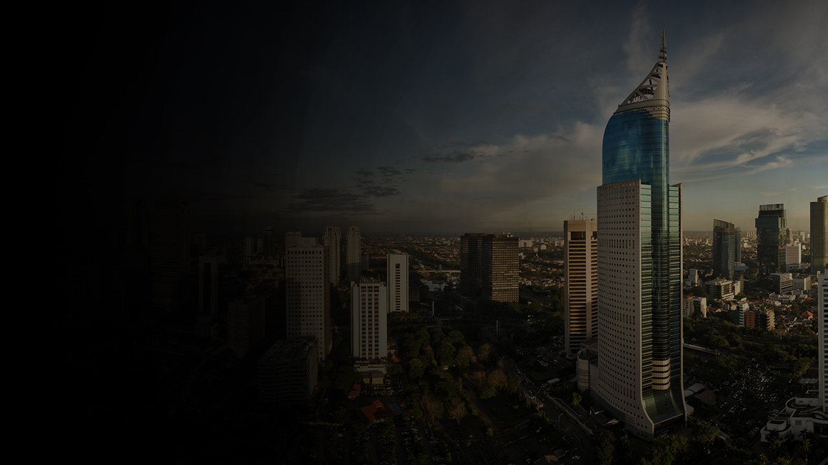


PARTNER COUNTRY 2021: INDONESIA
Resource-rich country (4th most populous in the world) and member of G20
Largest economy in the Association of Southeast Asian Nations (ASEAN)
Via the initiative “Making Indonesia 4.0” the Indonesian government is providing incentives to introduce 4.0 technologies in the key industrial sectors and to expand the digital economy
The government is channelling significant investment into electromobility and electric vehicles, the expansion of the industrial base and energy infrastructure, as well as the development of the supply chain ecosystem
President Joko Widowo is planning to visit HANNOVER MESSE, where he will open the National Pavilion and the German-Indonesian Business Summit. He will be accompanied by a large business delegation.

Slide 5

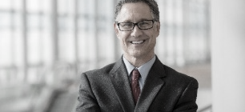
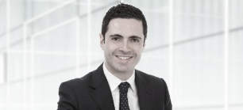


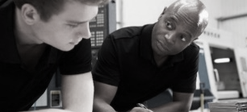
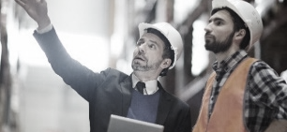

meeting place for the industry community
CEO
ENERGY MANAGEMENT
SOFTWARE & IT
PRODUCTION
DEVELOPMENT
& CONSTRUCTION
INTRALOGISTICS
140,000
72%
50,000
OF TRADE VISITORS PLAN TO VISIT THE NEXT HANNOVER MESSE
Top goals of your visitors:
Search for innovations
Search for suppliers
Initiation of new business contacts
Networking & exchange of knowledge
SENIOR INTERNATIONAL DECISION-MAKERS
ACTIVE APPOINTMENT
& CONTACT REQUESTS
40%
>80%
2,500
OF VISITORS
ATTEND NO OTHER
TRADE FAIR
OF TRADE VISITORS RECOMMEND HANNOVER MESSE TO OTHERS
Journalists
FROM 51 COUNTRIES

Slide 6
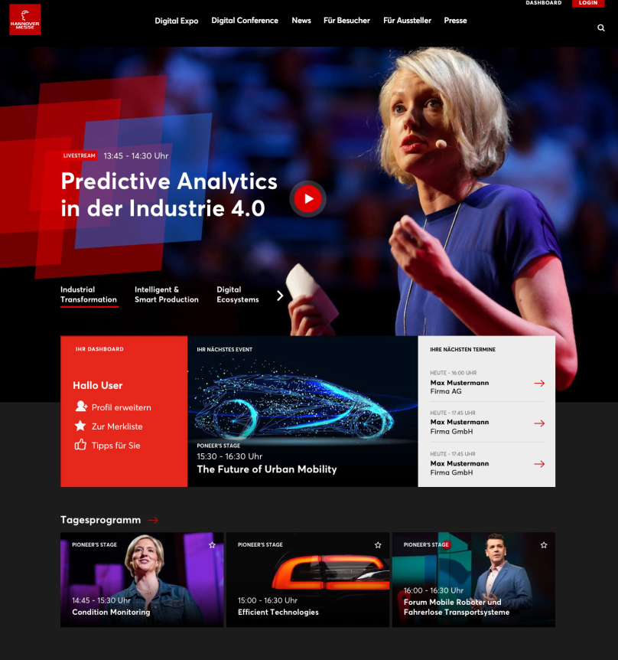






High digital reach
160,000
international newsletter subscribers
#HM19:
1.3 Million visitors (unique)
More than 100,000
FOLLOWERS
2.4 Million
Searches for
exhibitors and
products
13.5 Million PAGE VIEWS
180,000
streaming views
of digital conferences
at #HM19
45%
INTERNATIONAL ACCESS
FROM OVER 150 COUNTRIES

Slide 7
HANNOVER MESSE 2021
Digital Edition
Expo
Conference
Networking
Innovation
Here, everything revolves around your products and solutions.
Showcase innovations and best-case applications and take advantage of all the opportunities to inspire your customers with a digital presence via livestream, video tutorials or live chat.
inspiration
Inspiring keynotes, top speakers and partners.
The interactive conference program of the HANNOVER MESSE Digital Edition discusses the trends and future topics of the industry over five days.
Become part of the program with your own livestream events.
interaction
HANNOVER MESSE is the meeting place for the industry community!
Publish your specialist experts and consult your business contacts simply by video call.
Matchmaking and Business Dating offer new contact opportunities for even more interaction.

Slide 8

Lead theme INDUSTRIAL TRANSFORMATION:
BE A GUIDE AND SOURCE OF INSPIRATION
Digitization, individualization, climate protection and demographic change are driving industrial change.
Production, logistics and energy supply are changing rapidly.
New services and business models are emerging.
At HANNOVER MESSE, industrial customers are looking for products, tools, components, system solutions and cooperation partners with whom they can secure the competitiveness of their companies in times of change.
Take advantage of the HANNOVER MESSE theme to position yourself as a competence partner and solution provider.
Be a guide and source of inspiration for industry in times of industrial transformation.

Slide 9
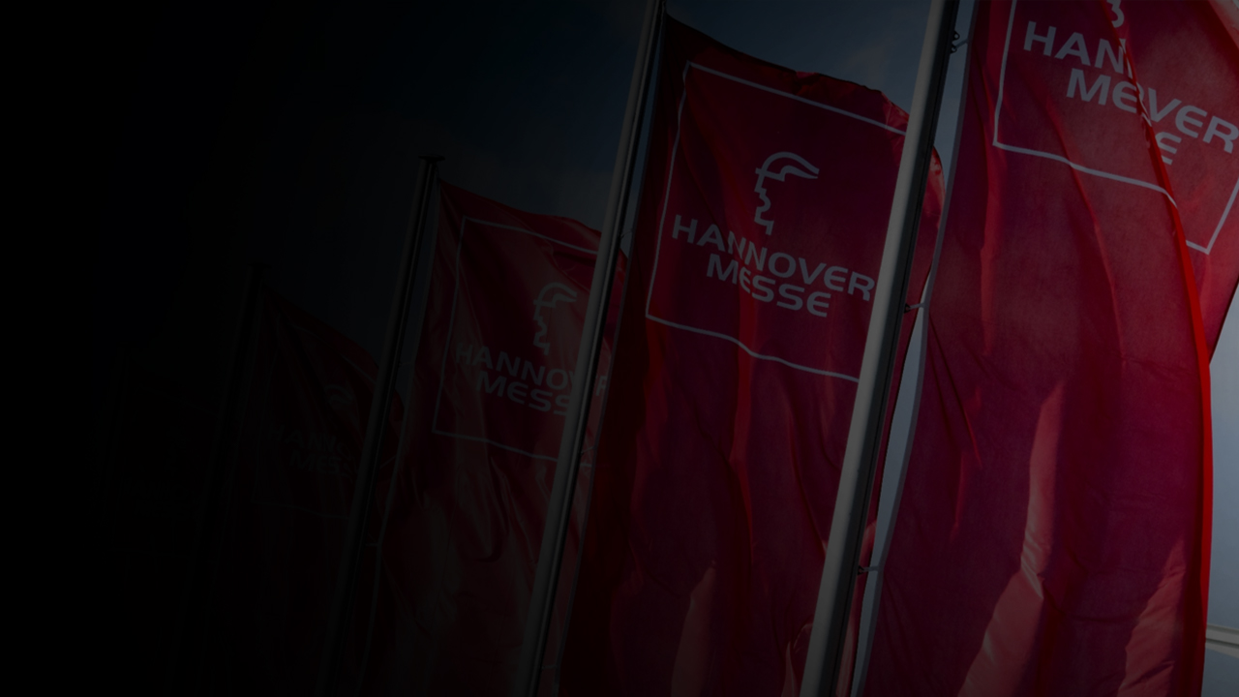
The leading global trade fair for your business in industrial production, intralogistics and energy supply:
Research & Development
design
Automation & drive technology
DATA, PLATFORMS & AI
Energy & Resource efficiency

Slide 10
12 -16 April 2021
Future Hub
Benchmark for Research, Young Talents and StartUps in 2021

Slide 11

World class synergies
RESEARCH & DEVELOPMENT
STARTUPS
THE FUTURE OF WORK
You are already thinking about the next transformation steps? You want to present innovations geared to future requirements?
The research hall is the place to be.
Do you belong to the innovators who are driving industrial transformation? If so, you should take part in “young tech enterprises”, the hub for game-changing technology.
Employer branding? Job offers? Career advice? – This is the right place for you!
CAREERS EXPO IN TUNE WITH INDUSTRY
SCIENCE MEETS BUSINESS MEETS POLITICS
“young tech enterprisesˮ –
THE STARTUP HUB AT HANNOVER MESSE
Tomorrow's industry will change the way people work. Future working environments, recruitment, further education and training – these topics are high up on the agenda.
Meet the right people. In Hannover you will find …
… senior decision-makers from industry, science and politics
… representatives of international networks and major project partners
Shaping the future together: “young tech enterprises” in Hall 24 is the global hub for pioneering industrial startups. It offers a first-class presentation area as well as a dialogue platform for forging successful alliances. It is where pioneers find the support their products and projects deserve – from people who are enthusiastic about new ideas.
CAREERS MARKET AT HANNOVER MESSE
ACHIEVE YOUR GOALS
Five action-packed days focusing on STEM-related careers: workshops, coaching, exclusive tours, consulting lounges, job walls with interesting job offers, plus extensive networking opportunities.
Know-how and technology transfer
Commercialization of research findings
Acquisition of external funding, investors and project partners
Positioning as a major centre of innovation and research
Young enterprises showcase their innovations
Around 150 international startups at a single venue
Pitches, matchmaking and extensive scope for networking
Industrial Startups Forum – All the relevant info for startups in the industrial sector

Slide 12
best supporting programme
TRANSFORMATION STAGE – TECH TRANSFER FORUM – INDUSTRIAL STARTUPS FORUM – JOB HUB
Do your ideas have a decisive influence on the transformation of industry? How do I develop my research into a marketable product? How do I bring my product to market? Which financing scenario best fits my business model? How do I find the best employees? And these are only a few of the questions discussed in our extensive program...
VISITOR GUIDANCE – ATTRACT ATTENTION
Meeting place for the pioneers of industry, branded shuttle buses for the Future Hub, the Future Path across the site, advertising measures already at the site entrances, reach into digital space through social media, streaming. The transformation of industry starts at Future Hub!

Slide 13
Your participation
Networking
Matchmaking - Business Dating - Networking
Exchange ideas with visitors about your innovations, products and solutions. Discuss current industry trends with speakers and other exhibitors.
You can find visitors specifically by interests, contact goals or other criteria, make appointments with them and get in touch via video call.
So the next business deal, the next partnership, the next successful business case is just one click away!
Use all the possibilities:
Publish your contact persons
Find other participants via interests, contact goals, industries, origin, etc. criteria
Appointments and personal diary
Business dating via video call

Slide 14
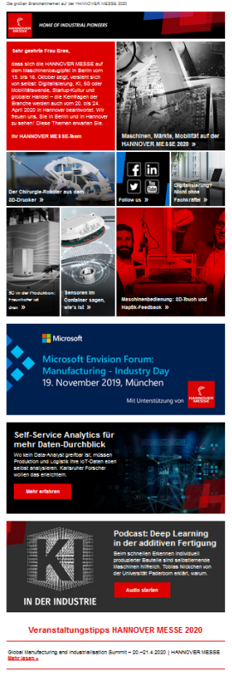

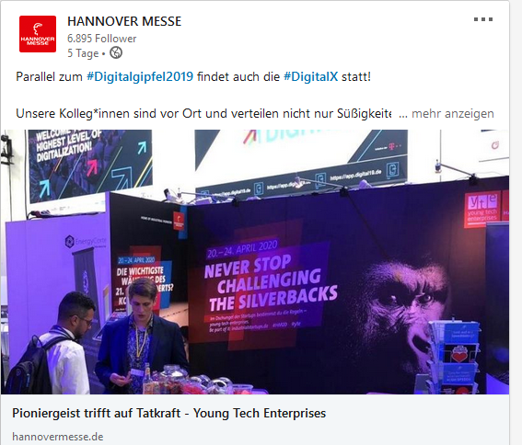
Image-ORIENTED, AGENDA-SETTING
Mass CommuniCation
Traditional advertising in general-interest and specialist media (print and online)
E-mail: customer retention and invitations / special e-mail campaigns
(approx. 170,000 newsletter subscribers)
Editorial development of the lead theme and trend topics
Live appearances at external events and sponsorship events

Slide 15

Personal contact remains irreplaceable:
The Business Dating
Nothing is more important in the current times than personal exchange - use Business Dating to maintain digital contacts and acquire new customers. There are various options available to you for this: By means of an appointment request, you can arrange video calls, text chats or meetings to follow up. The contact initiation is based on search requests and can also be initiated by the exhibitor. So go on a targeted search for new customers!
Please note: Visitors must actively agree to be contacted by the exhibitor for data protection reasons.
46 % of DMAG visitors rate the provision of a platform for video chats, including in particular 1:1 chats with exhibitors, visitors and speakers as very important - nothing is more important in the current climate than personal exchange.

Slide 16
PARTNER COUNTRY 2021:
The HANNOVER MESSE partner country has the opportunity to…
Attract global investors and boost its own exports.
Prove to the whole world that it is a first-class provider of high-quality and innovative products and solutions.
Present itself as an attractive location to invest in that reliably supports the establishment and growth of international businesses.
Further its own industrial political strategies and establish international partnerships.
Help its own businesses to acquire new customers around the world, thereby globally expanding its own economy.

Slide 17
PARTNER COUNTRY Benefits
The
Establish a profile as a leading industrial nation in the eyes of the entire world
Advancing the industrial policy agendas
Promoting the benefits of investing in the Indonesian Economy
Highlighting the importance of environmentally responsible and sustainable production
Initiating new business cooperation relationships and strengthened existing partnerships into the long-term future
Forging new links with foreign industrial associations.

Slide 18
PARTNER COUNTRY Benefits
The
What will companies achieve?
Recruiting new customers and partners
Meeting top decision-makers from all around the world
Expanding personal networks
Discovering new markets for products and services
First-Hand intelligence on the worldwide competition in all industrial sectors
Catching up on the latest trends and getting new ideas for their business
Knowledge - Leads – Contacts – Cooperation – Contracts - Business - Value

